Slide 1
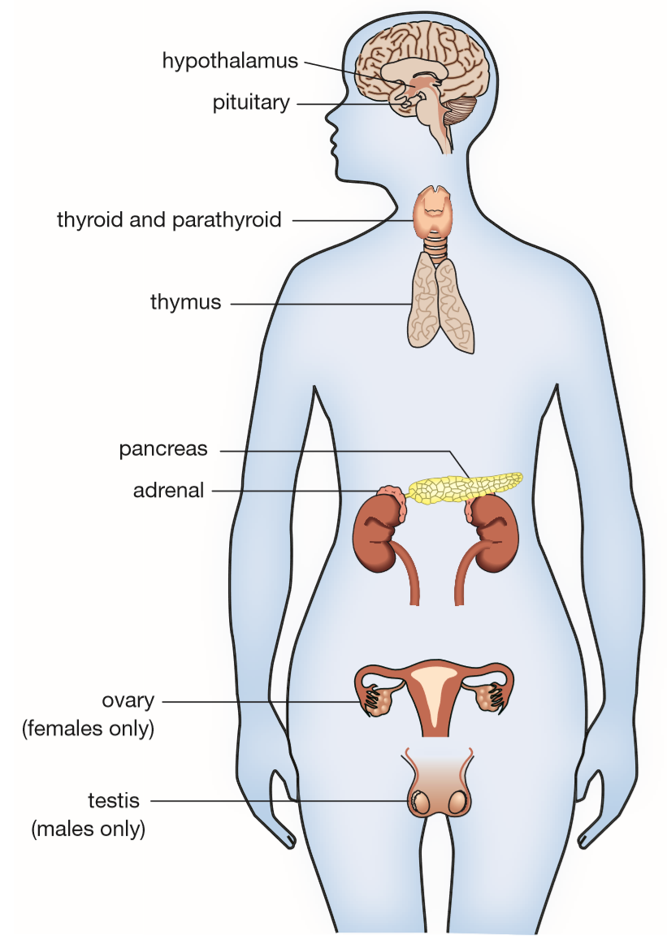
Daily Review
The endocrine system is a collection of glands and organs that secrete hormones into the bloodstream.
Its function is to maintain the body’s internal environment.
List four different endocrine hormones in the body.

Slide 2
Daily Review
Hormones are specific to their target cells. They fit together like a lock and key.
This is a diagram of a target cell. It has receptors for a hormone on it.
These are three different hormones. Which one will have an effect on the target cell? How do you know?
Hormone A
Hormone B
Hormone C

Slide 3
Daily Review
Homeostasis is the process of regulating the internal conditions of the body.
Homeostasis works to control the body’s temperature, water level, energy, oxygen, and wastes in the blood.
Homeostasis involves receptors that are sensitive to a particular stimulus, and effectors that have an effect on the same stimulus (stimulus-response model).
Which part of the brain constantly monitors and detects changes in the body’s internal environment?
Vocabulary
Homeo = same Stasis = stable

Slide 4
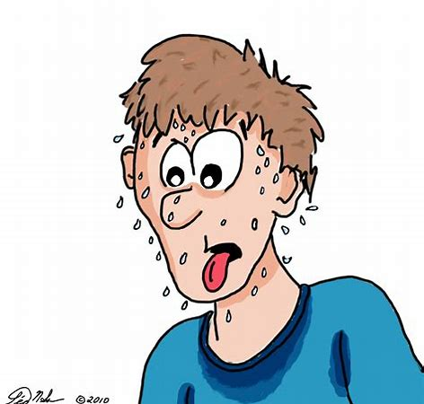
Skill Development/Guided Practice
Reminder
Negative feedback works by removing the original stimulus. It has the opposite effect.
Negative feedback occurs when the body responds to remove a stimulus.
Describe the negative feedback loop for the body responding to increased body temperature by sweating.
Increase in Body Temperature
Decrease in Body Temperature
Sweating

Slide 5
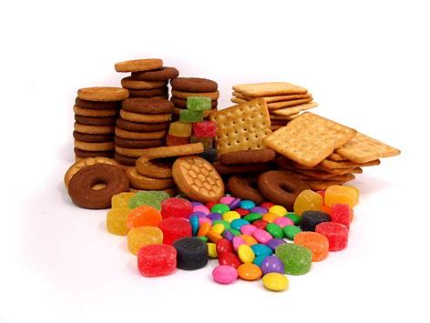
Skill Development/Guided Practice
Describe the negative feedback loop for the body responding to low blood sugar (glucose) by eating a sugary snack.
Decrease in Blood Glucose level
Eat a sugary snack
Increase in Blood Glucose level

Slide 6
Blood Glucose Regulation
Year 9 Biology

Slide 7
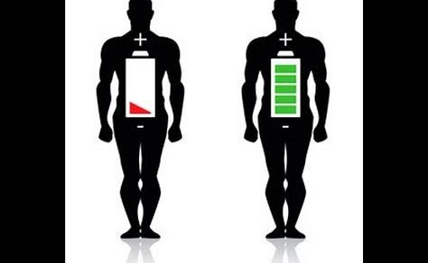
Learning Objectives
CFU
What are we going to learn?
Explain how the endocrine system regulates blood glucose levels through negative feedback.
Activate Prior Knowledge
To provide energy for your body throughout the day, your cells need a continuous supply of glucose.
Think, Pair, Share:
What are some activities that require a lot of energy?

Slide 8
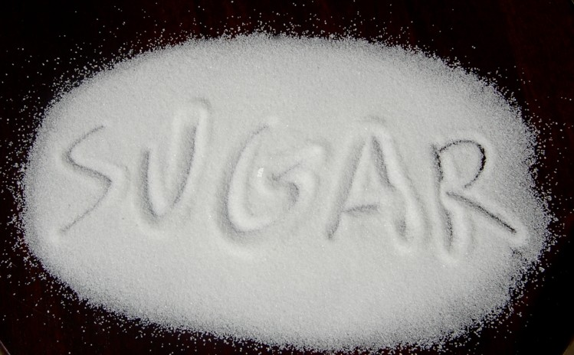
Concept Development
CFU 1
What is glucose?
Blood Glucose
Glucose is a type of sugar used by the body to provide energy for cellular respiration.
It is transported around the body, to cells, through the blood after it has been absorbed through digestion.
CFU 2
How does glucose move through the body?

Slide 9
Concept Development
CFU 1
What is glucose?
Blood Glucose
Sometimes there is too much glucose in the blood, and sometimes there is not enough.
Eating causes blood glucose levels to rise.
Vigorous exercise causes blood glucose levels to fall.
However you don’t spend all your time eating to keep blood sugar high. Instead the level of sugar in the blood is controlled by hormones.
CFU 2
Think, Pair, Share: At what time/s of the day would our blood glucose levels be at their highest?

Slide 10
Concept Development
CFU 1
What is the normal blood glucose level?
Blood Glucose
Too much glucose makes your blood thick, meaning that it can move only slowly through your blood vessels.
Too little glucose makes you feel dizzy because you have insufficient energy.
Due to homeostasis and negative feedback, blood glucose levels remain fairly constant at about 0.8–1mg/mL.
The steady concentration is due to the action of two hormones: insulin and glucagon.
These hormones are made by groups of specialised cells in the pancreas, called ‘islets’.
CFU 2
Which two hormones affect blood glucose levels?
CFU 3
Where are they secreted from? Hypothalamus Pituitary Gland Pancreas

Slide 11
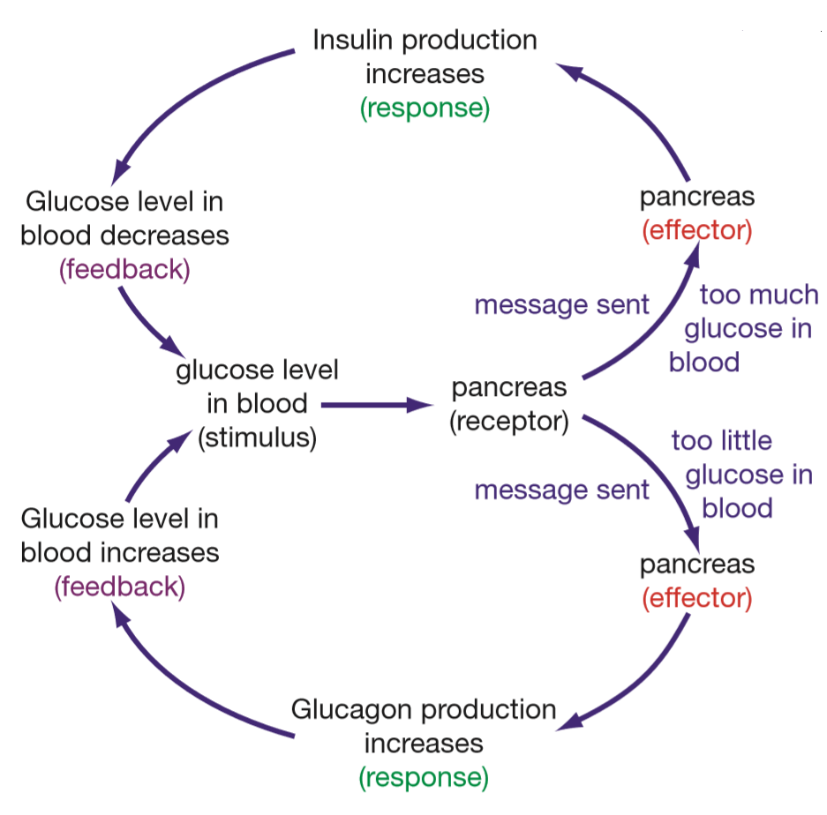
Concept Development
CFU 1
Which endocrine gland controls blood glucose?
CFU 2
Which hormone is released in response to high blood glucose?
Regulating Blood Glucose
Blood glucose levels are controlled by the pancreas.
When blood glucose is high (stimulus), the pancreas secretes insulin.
Insulin causes muscle and liver cells to store glucose, removing the stimulus through negative feedback.
CFU 3
What does insulin do?

Slide 12
Concept Development
CFU 1
Which endocrine gland controls blood glucose?
CFU 2
Which hormone is released in response to low blood sugar?
Regulating Blood Glucose
When blood glucose is low (stimulus), pancreas secretes glucagon.
Glucagon causes muscle and liver cells to release glucose into the blood, removing the stimulus.
Glucagon has the opposite effect to insulin.
By the controlled release of the two hormones, glucose levels are kept fairly constant.
CFU 3
What is the effect of glucagon?

Slide 13
Skill Development/Guided Practice
Reminder
Negative feedback works by removing the original stimulus. It has the opposite effect.
Describe the negative feedback loop for the body responding to decreased blood glucose levels.
Decrease in blood glucose
Pancreas secretes glucagon
Glucagon causes liver to release glucose
Increase in blood glucose level

Slide 14
Skill Development/Guided Practice
Reminder
Negative feedback works by removing the original stimulus. It has the opposite effect.
Describe the negative feedback loop for the body responding to increased blood glucose levels.
Increase in blood glucose
Pancreas secretes insulin
Insulin causes liver to absorb glucose
Decrease in blood glucose level

Slide 15
Skill Development/Guided Practice
Reminder
Negative feedback works by removing the original stimulus. It has the opposite effect.
Describe the negative feedback loop for the body responding to a change in blood glucose levels after you eat a meal.
Increase in blood glucose
Pancreas secretes insulin
Insulin causes liver to absorb glucose
Decrease in blood glucose level

Slide 16
Skill Development/Guided Practice
Reminder
Negative feedback works by removing the original stimulus. It has the opposite effect.
Describe the negative feedback loop for the body responding to a change in blood glucose levels after you go for a long run.
Decrease in blood glucose
Pancreas secretes glucagon
Glucagon causes liver to release glucose
Increase in blood glucose level

Slide 17
Relevance
Our bodies are complex organisms that are constantly responding to changes in the external and internal environment.
Knowing about the endocrine system and blood sugar levels helps you understand how our body maintains its optimal internal environment.

Slide 18
Skill Closure
What is glucose?
Skill Closure
How is the pancreas involved in regulating blood glucose levels?
Skill Closure
What role does the liver play in regulating blood glucose levels?

Slide 19
Independent Practice
Increases/decreases
Copy and complete the following flow chart in your book or device, with the title ‘Regulating Blood Glucose’.
( Choose either ‘increases’ or ‘decreases’)
2. Complete the Homeostasis worksheet.
Increases/decreases
Marigold
Rafflesia
Cactus
Increases/decreases
Trumpet Vine
Jasmine
Bottlebrush
Increases/decreases

